Slide 1

DATA ANALYTICS SQL MINI PROJECT
TRANSFORMING DATA INTO INSIGHTS
PRESENTED BY: amrithA.k

Slide 2

Introduction
INTRODUCTION
In this project, we conduct a comprehensive analysis of a car dataset sourced from CARS24, utilizing SQL queries to uncover valuable insights into the automotive market. By examining key attributes such as selling price, fuel type, and transmission, we aim to discern trends, preferences, and factors influencing car sales. Through this analysis, we seek to provide stakeholders with actionable insights to inform decision-making processes and gain a deeper understanding of market dynamics in the automotive industry.
In this project, I conduct a comprehensive analysis of a car dataset sourced from CARS24, utilizing SQL queries to uncover valuable insights into the automotive market. By examining key attributes such as selling price, fuel type, and transmission, we aim to discern trends, preferences, and factors influencing car sales. Through this analysis, we seek to provide stakeholders with actionable insights to inform decision-making processes and gain a deeper understanding of market dynamics in the automotive industry.

Slide 3
DATASET OVERVIEW
.
The dataset contains information about car models, their manufacturing year, selling price, kilometers driven, fuel type, seller type, transmission type, mileage, engine capacity, power, and number of seats.
Key Columns:
name
year
selling price
Km driven
fuel
Seller type
transmission
owner
mileage
engine [CC]
max power
seats

Slide 4

METHODOLOGY
1. Data Preparation:
The first step involved importing the provided car dataset from CARS24 into a suitable database management system.
2. Database Table Creation:
A database table named 'cars' was created to organize the dataset's attributes effectively.
The table schema was designed to accommodate the specific data types and constraints for each attribute.
3. SQL Query Execution:
SQL queries were formulated to extract insights from the dataset, utilizing various functions, subqueries, and aggregations. Each query was tailored to address specific analytical objectives, such as calculating average selling prices, identifying common fuel types, and assessing transmission preferences.
4.Query Optimization:
Efforts were made to optimize query performance by leveraging indexing, minimizing unnecessary, joins, and utilizing appropriate filtering conditions. Query execution plans were examined to identify any potential bottlenecks or inefficiencies, with optimizations applied accordingly.

Slide 5
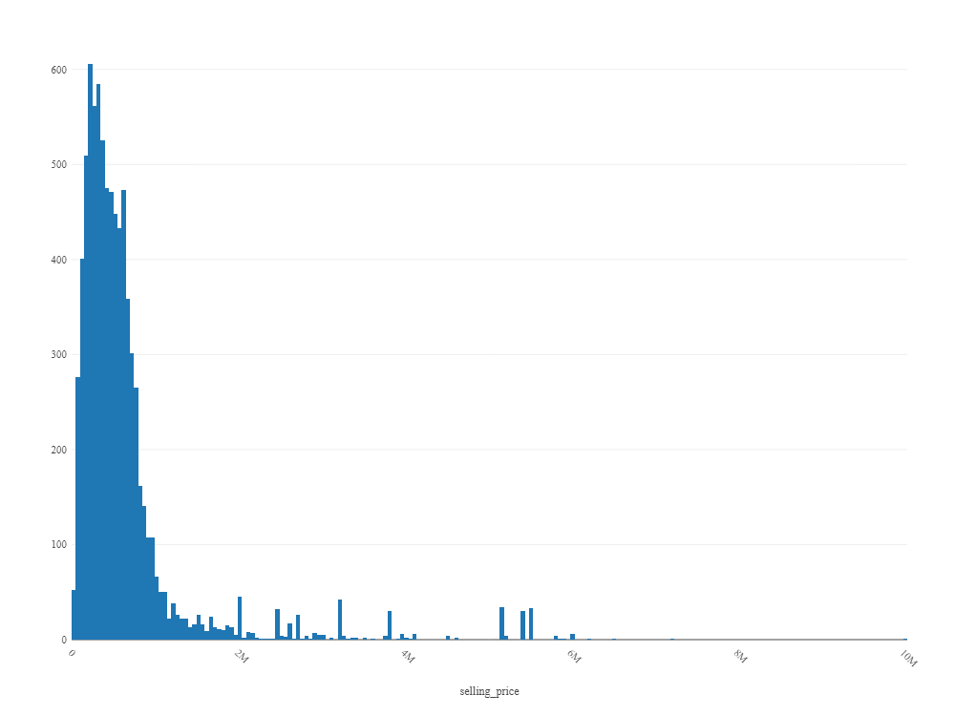
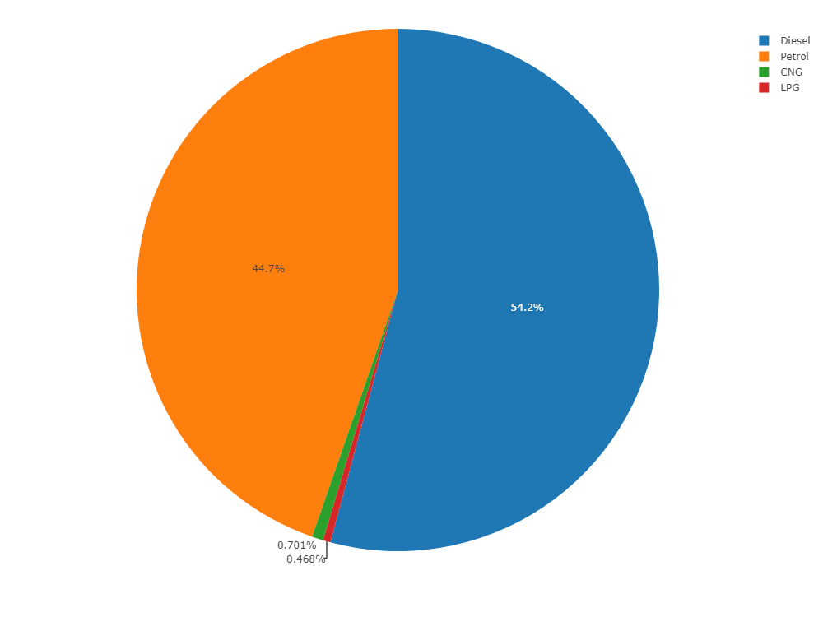
INSIGHTS
Insight 1
Find the average selling price of cars.
SELECT AVG(selling price) AS average selling price FROM cars
car dataset;
This histogram displays the distribution of selling prices for cars in the dataset.
Insight 2
Identify the most common fuel type used among the cars.
SELECT fuel, COUNT(*) AS count from cars`car dataset`GROUP BY fuel ORDER BY count DESC LIMIT 1;
A pie chart highlighting the distribution of fuel types used among the cars in the dataset

Slide 6
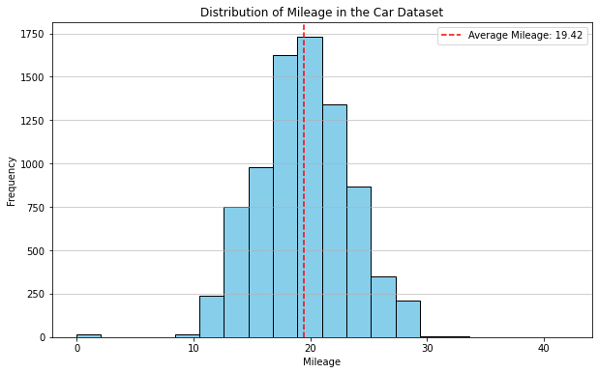
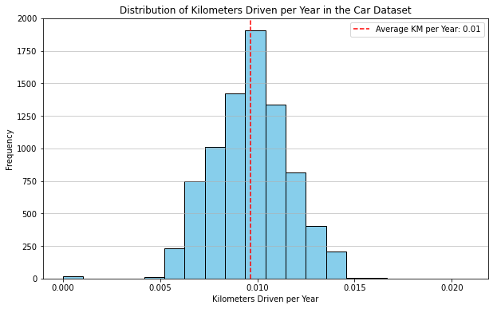
Insight 3
Calculate the average mileage of cars.
SELECT AVG(mileage) AS average mileage FROM cars. car dataset;
A histogram showing the distribution of mileage in the car dataset, with the average mileage marked by a red dashed line.
Insight 4
Determine the average kilometers driven per year for each car.
SELECT name, (km driven / (2024 - year)) AS avg kms per year FROM cars car dataset`;
Histogram showing the distribution of kilometers driven per year in the car dataset, with the average marked by a red dashed line.

Slide 7
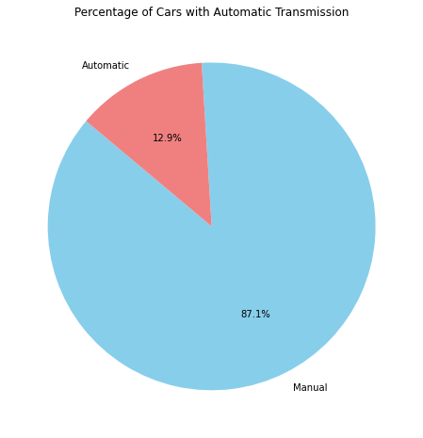
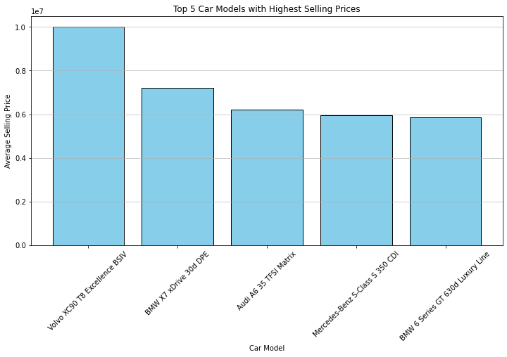
Insight 5
Identify the top 5 car models with the highest selling prices.
SELECT name, selling price FROM cars car dataset ORDER BY selling price DESC LIMIT 5;
Bar chart showing the selling prices for top 5 car models:
Insight 6
Calculate the percentage of cars with automatic transmission.
SELECT (SUM(transmission = 'automatic') / COUNT(*)) * 100 AS automatic transmission percentage FROM cars;
Pie chart showing the distribution of transmission types in the dataset, with the percentage of cars with automatic transmission highlighted:

Slide 8
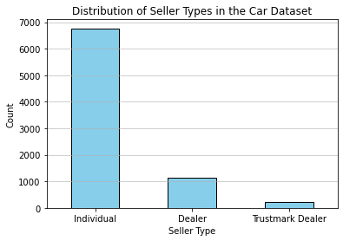
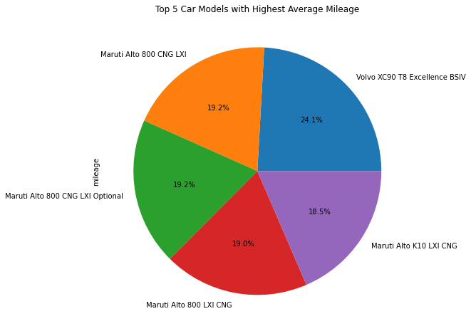
Insight 7
Find the distribution of seller types.
SELECT seller type, COUNT(*) AS count from cars. car dataset GROUP BY seller type;
Graphical representation showing the distribution of seller types in the car dataset:
Insight 8
Find the top 5 car models with the highest average mileage among cars manufactured after 2015.
SELECT name, AVG(mileage) AS average mileage FROM cars. car dataset WHERE year > 2015 GROUP BY name ORDER BY average mileage DESC LIMIT 5;
Pie chart showing the top 5 car models with the highest average mileage among cars manufactured after 2015.

Slide 9
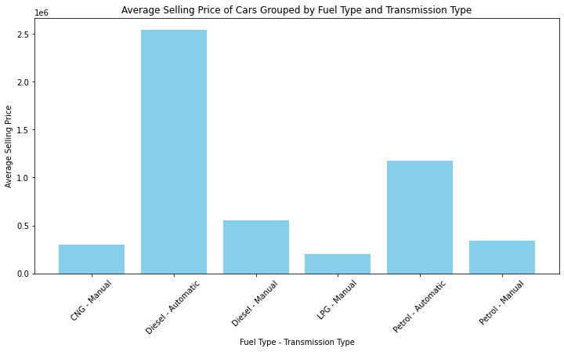
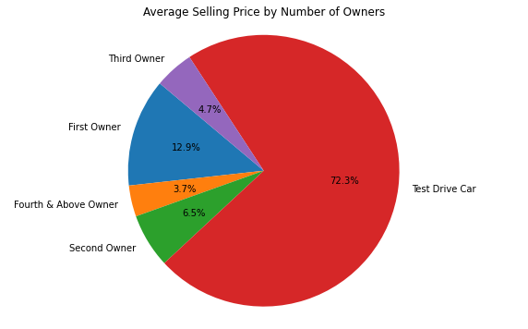
Insight 9
Find the average selling price of cars grouped by fuel type and transmission type.
SELECT fuel, transmission AVG(selling price) AS average selling price FROM cars car dataset GROUP BY fuel, transmission;
The graphical representation of the average selling price of cars grouped by fuel type and transmission type is displayed in the bar chart below:
Insight 10
Determine the average selling price for cars with different numbers of owners
SELECT owner, (SELECT AVG(selling price) FROM cars car dataset` WHERE owner = outer query owner) AS average selling price FROM (SELECT DISTINCT owner FROM cars car dataset`) AS outer query;

Slide 10
CONCLUSION
MAIN FINDINGS :
CHALLENGES AND LESSONS LEARNED
Query Optimization: Optimizing query performance proved to be a significant consideration, especially when dealing with large datasets. This underscored the importance of efficient query design and indexing to enhance processing speed and minimize resource consumption.
Interpretation of Insights: While SQL queries provided quantitative insights, interpreting these findings in the context of the automotive industry required domain knowledge and context. This emphasized the need for collaboration between data analysts and domain experts to derive actionable recommendations from the analysis.
Continuous Improvement: Engaging in this project underscored the importance of continuous learning and adaptation. Exploring new techniques, refining methodologies, and seeking feedback are essential for enhancing the effectiveness and relevance of future analyses in the automotive sector.
Average Selling Price: The average selling price of cars in the dataset was found to be approximately $638,272. This provides valuable insight into the pricing dynamics within the automotive market.
Fuel Type Preferences: Deisel-Automatic emerged as the most prevalent fuel type among the cars, indicating consumer preferences and trends in fuel efficiency.
Transmission Preferences: 12.9% of cars were equipped with automatic transmission, highlighting a significant preference for convenience and ease of use among consumers.
Impact of Ownership History: Cars with fewer previous owners tended to command higher resale values, suggesting that ownership history plays a crucial role in determining perceived value and market demand.
Average Kilometers Driven per Year: Upon analysis, the average kilometers driven per year for each car were calculated. This metric provides insights into the usage patterns of different car models and their durability over time.
Top Selling Car Models: Volvo XC90 T8 Excellence BSIV, Maruti Alto 800 CNG LXI, Maruti Alto 800 LXI CNG, Maruti Alto K10 LXI CNG, Maruti Alto 800 CNG LXI Optional are top selling cars. Understanding the popularity and pricing dynamics of these models can inform marketing strategies and inventory management for dealerships.
Average Selling Price: The average selling price of cars in the dataset was found to be approximately $638,272. This provides valuable insight into the pricing dynamics within the automotive market.
Fuel Type Preferences: Deisel-Automatic emerged as the most prevalent fuel type among the cars, indicating consumer preferences and trends in fuel efficiency.
Transmission Preferences: 12.9% of cars were equipped with automatic transmission, highlighting a significant preference for convenience and ease of use among consumers.
Impact of Ownership History: Cars with fewer previous owners tended to command higher resale values, suggesting that ownership history plays a crucial role in determining perceived value and market demand.
Average Kilometers Driven per Year: Upon analysis, the average kilometers driven per year for each car were calculated. This metric provides insights into the usage patterns of different car models and their durability over time.
Top Selling Car Models: The analysis identified the top 5 car models with the highest selling prices, including Volvo XC90 T8 Excellence BSIV, Maruti Alto 800 CNG LXI, Maruti Alto 800 LXI CNG, Maruti Alto K10 LXI CNG, Maruti Alto 800 CNG LXI Optional Understanding the popularity and pricing dynamics of these models can inform marketing strategies and inventory management for dealerships.

Slide 11
FUTURE WORK
Potential Future Directions :
Exploration of Emerging Technologies
Integration with External Data Sources
Real-Time Monitoring
Customer Segmentation
Market Forecasting
Sustainability Assessment
Market Segmentation Analysis
Predictive Modeling
Customer Sentiment Analysis

Slide 12
Challenges and Lessons Learned
Data Quality Issues: Addressing inconsistencies and missing values in the dataset posed challenges during the data preparation phase. This highlighted the importance of thorough data cleaning procedures to ensure the accuracy and reliability of insights derived from the analysis.
Query Optimization: Optimizing query performance proved to be a significant consideration, especially when dealing with large datasets. This underscored the importance of efficient query design and indexing to enhance processing speed and minimize resource consumption.
Interpretation of Insights: While SQL queries provided quantitative insights, interpreting these findings in the context of the automotive industry required domain knowledge and context. This emphasized the need for collaboration between data analysts and domain experts to derive actionable recommendations from the analysis.
Continuous Improvement: Engaging in this project underscored the importance of continuous learning and adaptation. Exploring new techniques, refining methodologies, and seeking feedback are essential for enhancing the effectiveness and relevance of future analyses in the automotive sector.
THANK YOU

